Slide 1
SEIA Perspective on
Smart Inverter Functions
Brandon Smithwood, SEIA
Damon Franz, Tesla
August 15, 2017

Slide 2
Smart Inverter Enabled Locational Benefits
Avoidance of investments needed to maintain voltages within Rule 2 limits
Enhanced Conservation Voltage Reduction
Data Services/Situational Awareness (June 7th ACR Group 3 item)

Slide 3
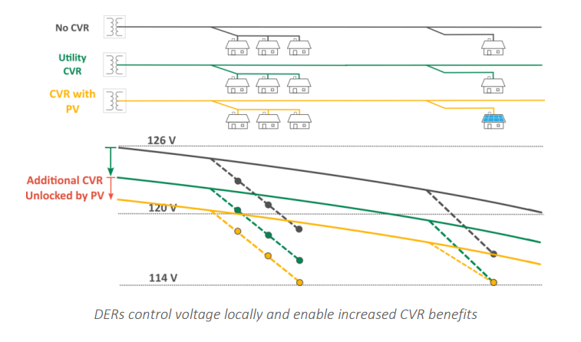
Conservation Voltage Reduction

Slide 4
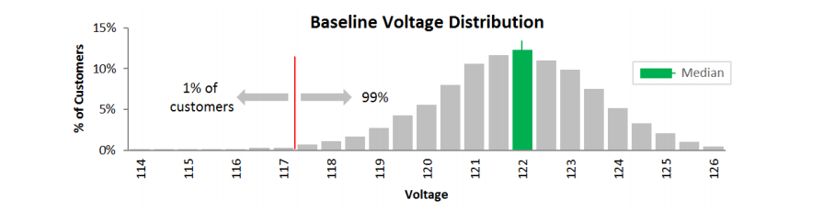
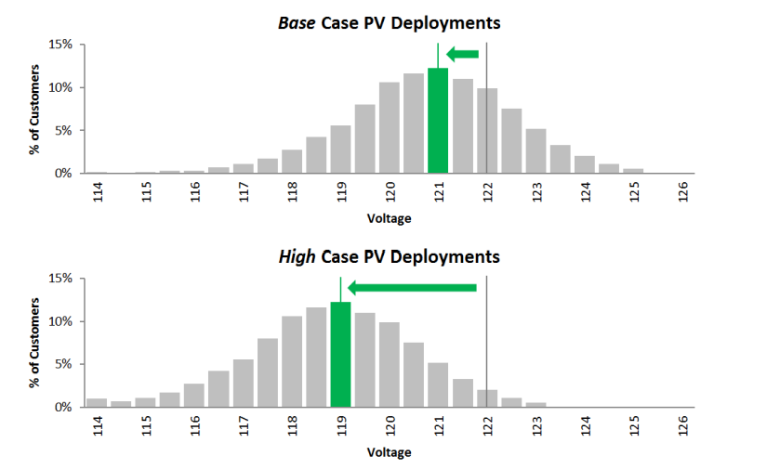
Conservation Voltage Reduction

Slide 5
Avoidance of Investments to Maintain Voltages
Value: DERs can avoid investments in voltage management equipment
  Equipment:
    Load tap changers
    Capacitors
    Line regulators
    Line reconductoring
There is a need for a 8760 VAR profile to capture ability of inverters to manage voltage through production or absorption of reactive power
  Currently the LNBA only captures voltage management benefits that come from reducing load
  SEIA is looking forward to the IOU’s development of this VAR profile

Slide 6
Conservation Voltage Reduction (IOU Positions)
PG&E:
  Quantifying this potential additional savings on any particular circuit requires understanding the extent to which CVR has already been achieved under standard practice. Any incremental CVR benefits beyond standard practice are highly dependent on a variety of factors specific to that circuit and the customer end use devices that are on that circuit.
  One simple method to estimate CVR energy savings is to use the CVR factor, which is the ratio of percent energy savings to percent voltage reduction: [percent energy savings] = [CVR Factor] x [percent voltage reduction]. (PG&E DRP Demonstration B Final Report, P. 15)

Slide 7
Conservation Voltage Reduction (IOU Positions)
SCE:
  SCE needs to perform detailed engineering analysis and field research which involve extensive testing over an extended period of time in order to accurately evaluate the benefit of CVR and/or VVO in its own system. In addition, necessary communications and controls will be required to enable the functionalities and full benefits of the program. Therefore, CVR and VVO are not currently estimated or otherwise included in Demo B LNBA values. (SCE LNBA Demo Final Report, P. 16)

Slide 8
Conservation Voltage Reduction (IOU Positions)
SDG&E
  Additional CVR-based energy consumption reduction beyond that achieved by standard practice may be achieved by more sophisticated voltage controls, such as those that enable VVO. The problem with crediting DERs for avoided costs through CVR, however, is twofold. First, quantifying the potential savings on any particular circuit requires thorough knowledge of how voltage level effects consumption which is highly dependent on a variety of factors specific to that circuit and the customer end use devices that are on that circuit. Second, to achieve CVR, DERs must be working in concert and be coordinated with utility devices; so CVR is a service that DERs individually cannot effectively provide. In addition to this, the avoided costs are mainly on the customer end and are not incremental investments. The two benefits would include the minor reduction in capacity constraints and the small reduction in losses due to less demand, which to accurately calculate would require rigorous dynamic powerflow studies. (SDG&E DRP Demonstration B Final Report, P. 12)

Slide 9
Rebuttal to IOU Arguments on CVR
Lack of modeling for greater granularity of CVR benefits does not mean this value should be assumed to be zero
The value is not de minimus: range of values from 1-3c per kWh of generation for strategically placed PV systems
This value has been demonstrated on PG&E and HECO distribution system models
Communications and control are not necessary: benefits can be realized through inverters set to dynamic volt/VAR acting autonomously

Slide 10
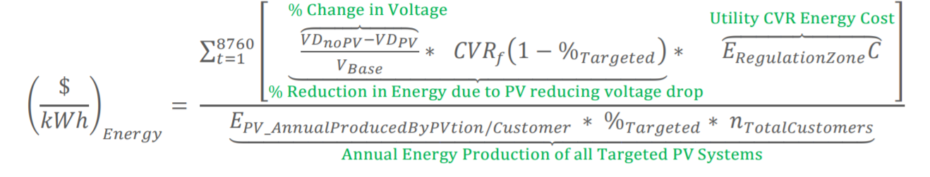
Conservation Voltage Reduction
Should be considered a system-wide value rather than a locational value
  Value is avoided energy and line losses
  Will vary by location, but limitations of secondary system modeling require an averaged, if more conservative, calculation
Should be calculated by summing incremental avoided energy and line losses

Slide 11
Data backhaul/situational awareness
This value will be discussed in the DRP Working Group as part of the Group III items identified in the June 7th Assigned Commissioner’s Ruling
Distributed energy resources collect a substantial amount of data at a nodal level, including data collected from smart inverters
This data can be transmitted more frequently than utility data and aggregated and analyzed for utility use
The value of this service could be calculated as the avoided cost of the utility-owned equipment that would otherwise be installed to provide the service.

